Slide 1

比特币 实现技术解析
持有、支付、挖掘比特币原理及协议
Andy Wu (吴增德）
2017－05－29
Notes:
Own, Send, Mine bitcoins
Public –Private Key Encryption
Question:
How the bitcoin is transferred, How the bitcoin is flowed
Bitcoin core code analysis
BitCoin Addresses:
Generate public / private key pair
Hash the public key → Bitcoin address
Guard the private key with your life
build an entire core banking platform on some form of distributed ledger technology.
One thing EWF potentially will work on, for example, is a unified blockchain platform
blockchain represents a real breakthrough when it comes to verifying "tiny little contracts in a point-to-point realm.“
sees blockchain as a breakthrough for traceability

Slide 2
How Bitcoin Works
Andy Wu (吴增德）
2017－05－29
Notes:
Own, Send, Mine bitcoins
Satoshi Nakamoto

Slide 3
Outline
Introduction
Sending Money
Transaction, Ledger & Bitcoin owning
Double Spending & Blockchain
Mining
Blockchain application
Summary
Reference
cryptographic Basic
reference documents
Ethereum

Slide 4
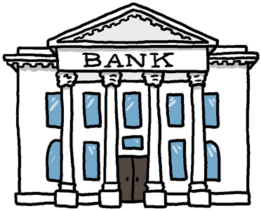
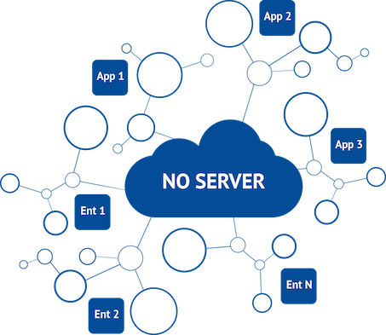
Introduction
World's first decentralized Cryptocurrency
Invented in 2009 by Satoshi Nakamoto (中本聪)
No bank or central authority
Distributed consensus system
Blockchain Viewer: Block, txn, Address, tree
.32,A->B
1.0,J->Z
1.45,C->S
1.0,H->J
1.03,S->J
.23,B->C
1.2,E->J
.9,M->B
2.5,M->S
.1,S->F
.2,M->J
1.3,S->S
...
...
...
...
HASH
HASH
HASH
Block 1
Block 2
Block 3
Block 4

Slide 5
What is Bitcoin
Ledger
____ ____
____ ____
____
Ledger
Ledger
____ ____
____ ____
____
Ledger
____ ____
____ ____
____
Alice | 5.4
Bob | 100
Frank | 700
Carlos | 0.0000001
… | 1
Ledger
____ ____
____ ____
____
Ledger
____ ____
____ ____
____
Ledger
____ ____
____ ____
____
Ledger
____ ____
____ ____
____
Ledger
____ ____
____ ____
____
Ledger
____ ____
____ ____
____
Ledger
____ ____
____ ____
____
Ledger
____ ____
____ ____
____
Ledger
____ ____
____ ____
____
Notes:
How transaction is done
How to transfer
RSA
Bitcoin cryptography
HASH 256
To understand: blockchain.info
Youtube: blockchain.info

Slide 6
Sending Money
Ledger
____ ____
____ ____
____
Ledger
____ ____
____ ____
____
Ledger
____ ____
____ ____
____
Ledger
____ ____
____ ____
____
Alice → Bob 5.0 BTC
Ledger
____ ____
____ ____
____
Ledger
____ ____
____ ____
____
Ledger
Alice 25
Bob 10
____ ____
Alice → Bob 5 BTC
June → Dave 8 BTC
Andy → Juan 6 BTC
Sam → John 4 BTC
20
15
Ledger
Alice 25
Bob 10
____ ____
20
15
Passing other’s transactions along
Ledger
Alice 25
Bob 10
____ ____
20
15
A→B
50 BTC
A→B
50 BTC
A→B
50 BTC

Slide 7
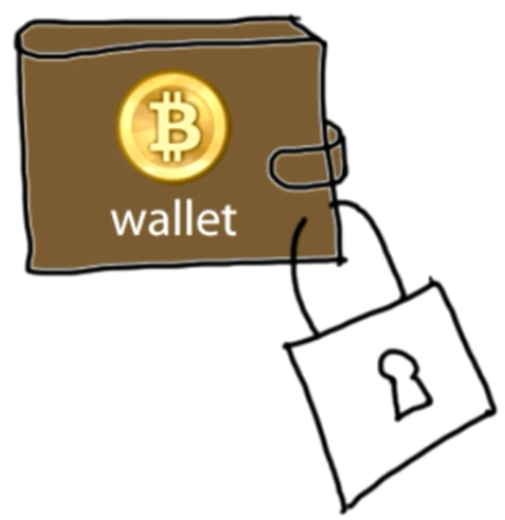
Sending Money & Authentication
Transaction Messages
Digital Signature
Alice → Bob 5 BTC d302721…
June → Dave 8 BTC 81758de…
Andy → Juan 6 BTC 17512c8…
Sam → John 4 BTC 9eac123…
? Alice ?
Digital Signature
Bf853d30272138df448817512c8de9cc3f75849eac1234cc …
different every time
Create
Verify
Signature = f(message, private key)
1=? V(message, public key, signature)

Slide 8
Digital Signature
Digital Signature Math
ecdsa (elliptic curve digital signature algorithm)
”mathematical trap door”
Transaction Message
Transaction Message
Transaction Message
Digital Signature
Transaction Message
Transaction Message
Transaction
493830493 493168268 …
Transaction
493830493 493178268 …
Transaction
493830493 493178268 …
Dig Signature
Dig Signature
Dig Signature

Slide 9
Transactions in more detail
Signature = f(message, private key)
1=? V(message, public key, signature)
Create
Verify
Input
A public key
that belongs to the redeemer of the output transaction.
2) An ECDSA hash
Output contains
Amount: being sent to the recipient.
Change
being sent back to the original sender (if any)
Voluntary transaction fee
Block chain
prevents the double spend attack
by giving other nodes the power to verify that transaction inputs were not already spent somewhere else.

Slide 10
Coins flow from Inputs to Outputs
Each bitcoin defined as a chain of digital signature
When A wants to transfer a bitcoin to B, A creates a digital signature with A’s private key, based on the hash of
The previous transaction of this coin
The public key of B
Everyone can verify the transaction by verifying the digital signature with public key of A
Create
Verify

Slide 11
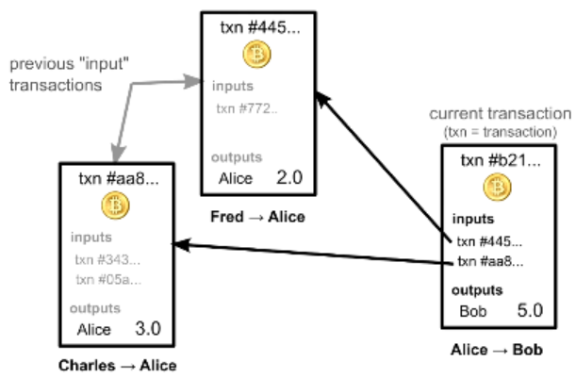
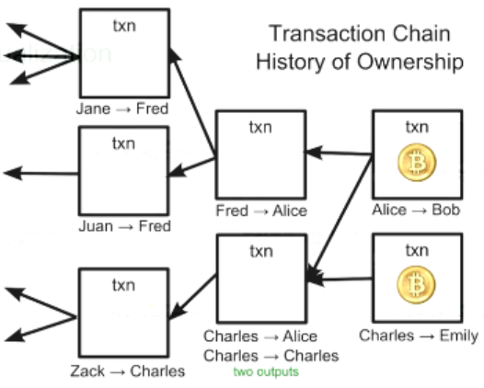
Transaction and Ledger
Ownership via previous transactions
Check previous transactions ~ 24h
Blockchain.info
Notes:
?? How the process pay 1.2, 2.5, 3.4

Slide 12
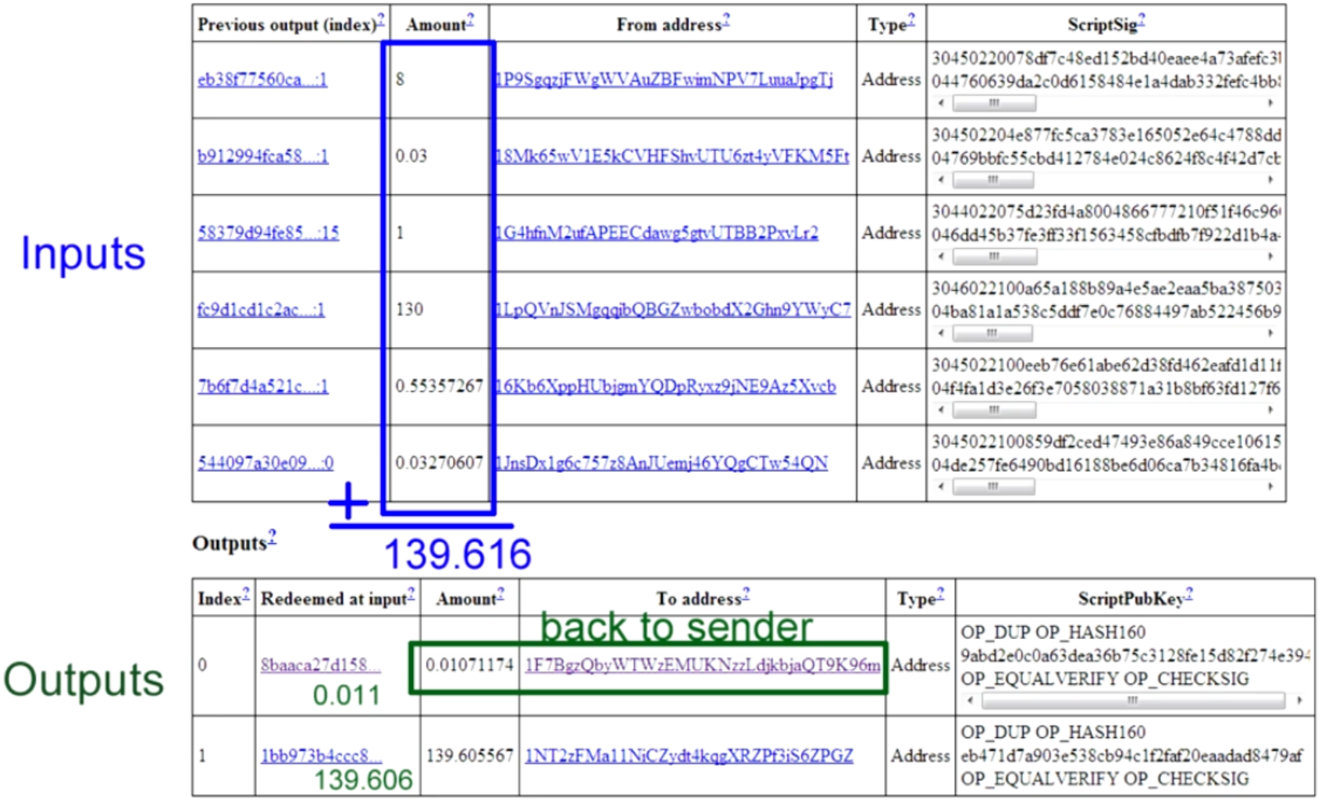
Real Transactions

Slide 13
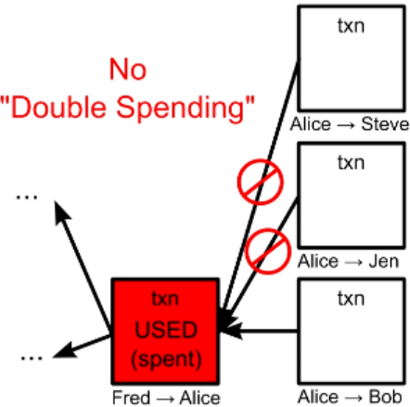
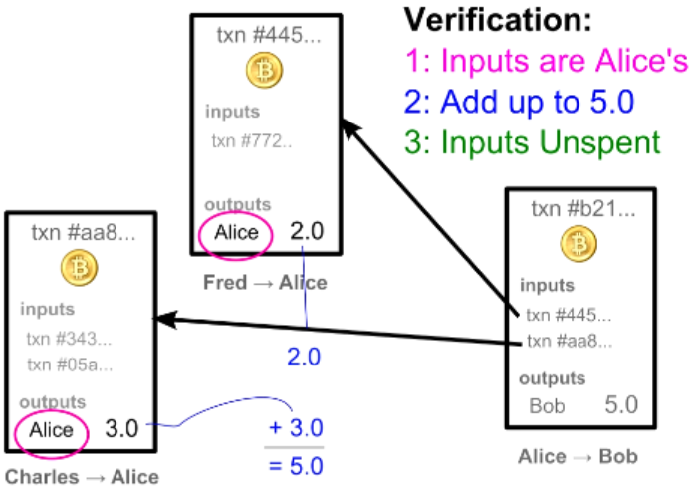
Transaction Verification
Each Transaction Can Only be Used Once as an input

Slide 14
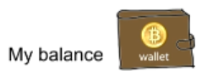
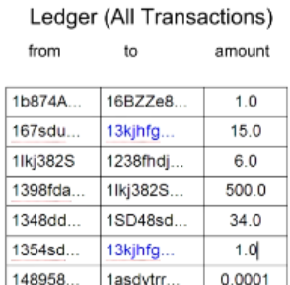
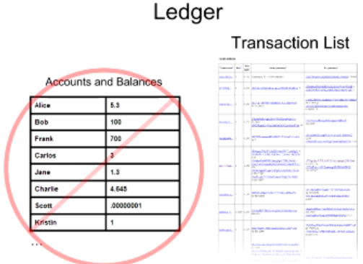
Balance Calculation
16

Slide 15
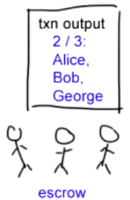
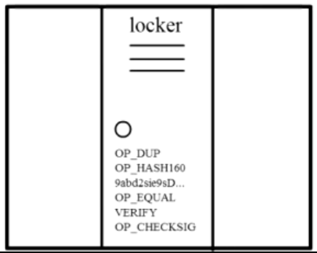
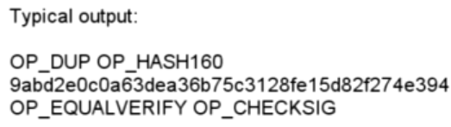
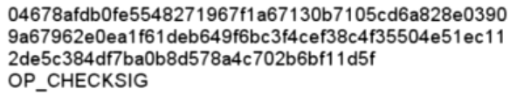
Complex Transactions: Mathematical Puzzles
Transactions: Mathematical Puzzles with locker
Defined with special Scripting language
Only owner can solve it
Support more complex conditions
First Transaction: 2009, Jan 3, 50BTC

Slide 16
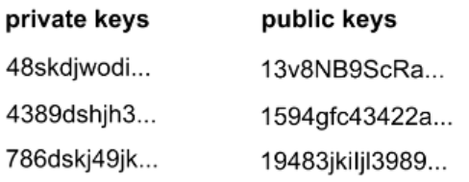
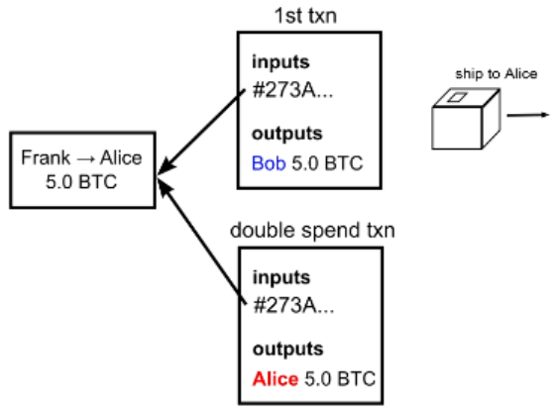
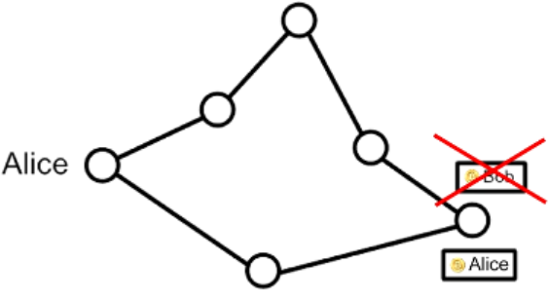
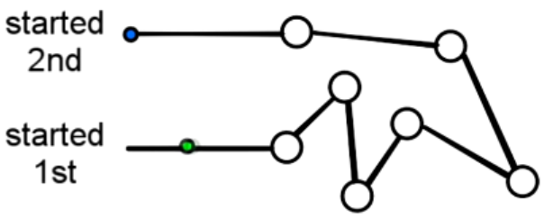
Transaction Security
Wallet
Anonymity
Possible bitcoin address: 2^160
Bitcoin transaction Security:
Digital Signatures
Referenced Transactions
Security Hole: Transaction Order
Double Spending Fraud
Nodes need to agree on transaction order

Slide 17
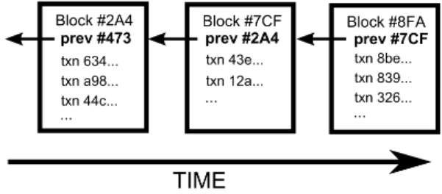
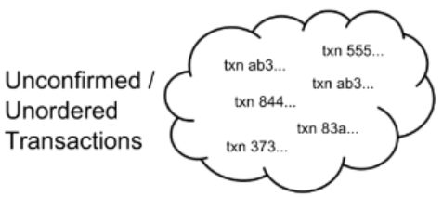
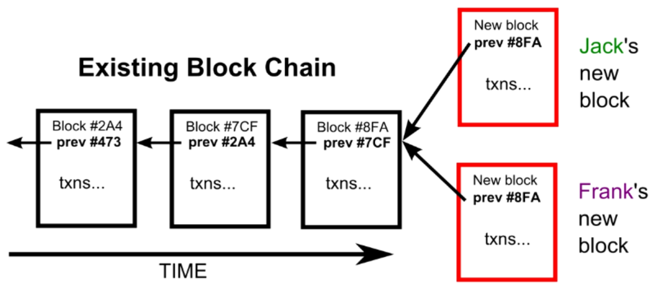
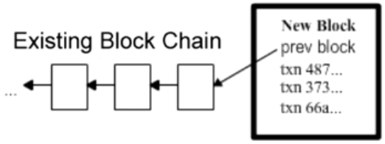
Block Chain
The Block Chain: Ordering Solution
Transaction Chain: History of Ownership
Unconfirmed Transactions
Add to new Block
Potential next blocks

Slide 18
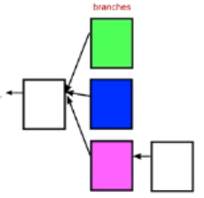
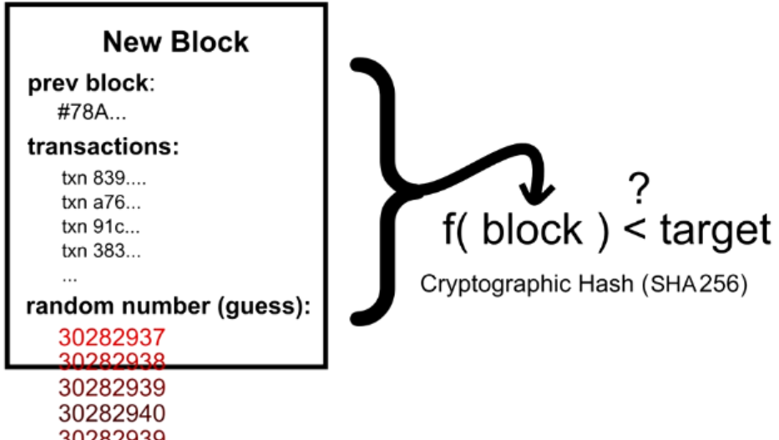
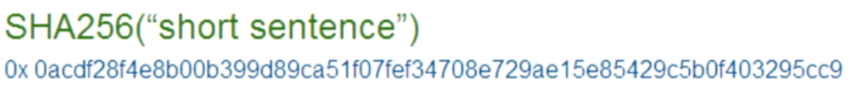
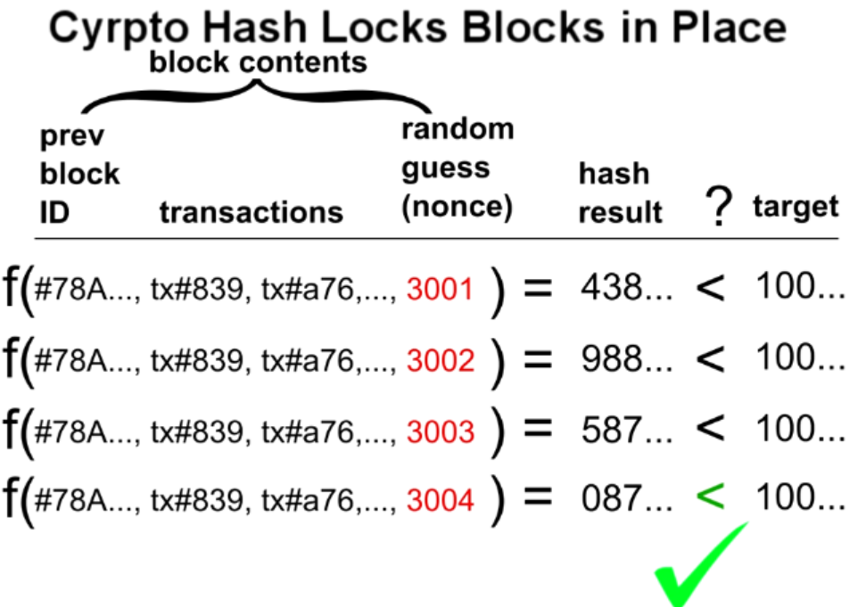
Cryptographic Hash
Block Puzzle
Block Puzzle: SHA256
Target: 000000000000A1B7E…

Slide 19
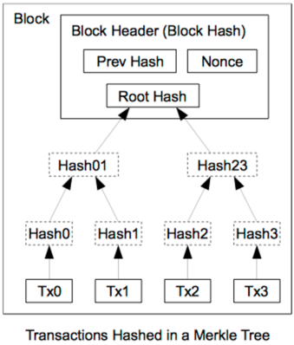
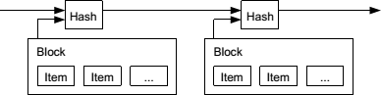
Block Header Hash Relations
Name | Byte Size | Description
Version (V) | 4 | Block Version Number.
Previous Hash (P_{h}) | 32 | This is the hash of the previous block header.
Merkle Root (H_{t}) | 32 | The hash based on all the transactions present in the current block.
Time (T) | 4 | Current Timestamp in seconds (unix format).
Target | 4 | Target value in compact form.
Nonce (R) | 4 | User adjusted value starting from 0.

Slide 20
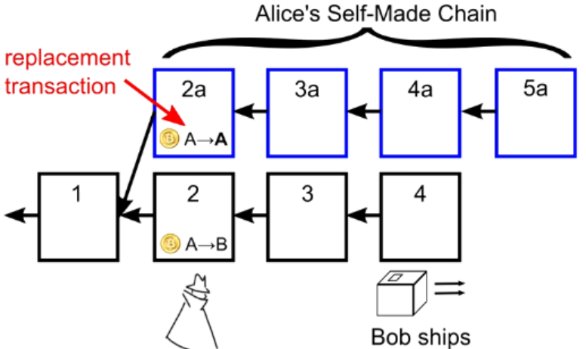
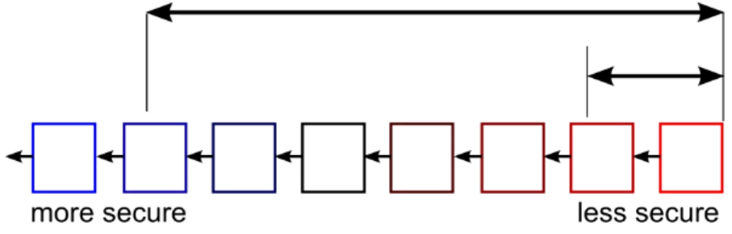
Double Spending Prevention
.32,A->B
1.0,J->Z
1.45,C->S
1.0,H->J
1.03,S->J
.23,B->C
1.2,E->J
.9,M->B
2.5,M->S
.1,S->F
.2,M->J
1.3,S->S
...
...
...
...
HASH
HASH
HASH
Block 1
Block 2
Block 3
Block 4
Wait for several block for safety

Slide 21
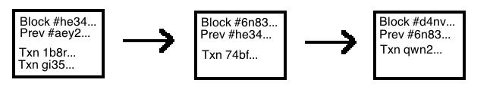
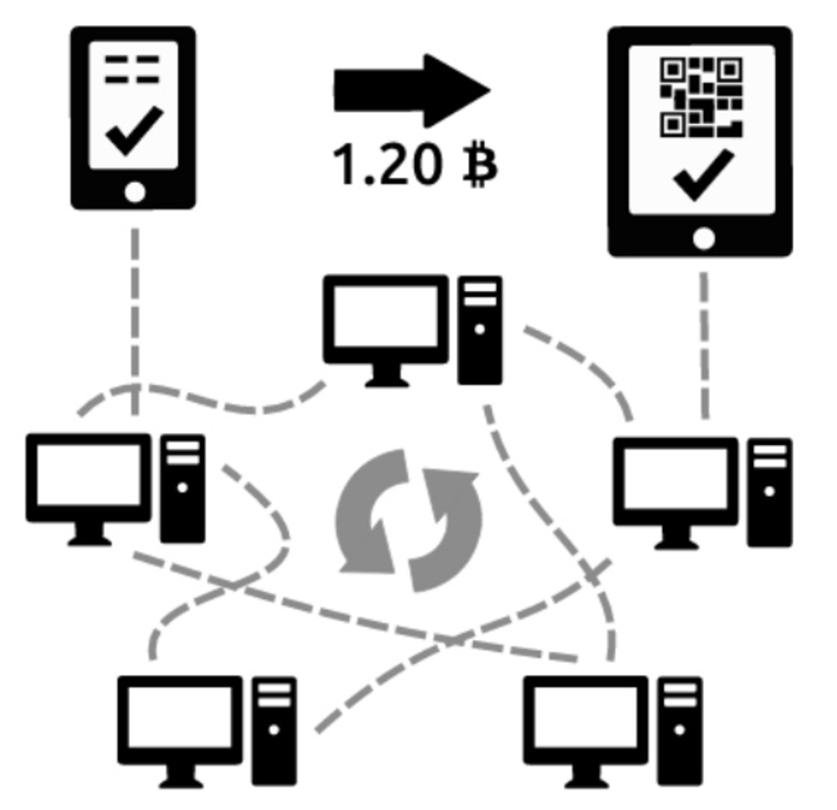


Recap
Time
Blockchain:
Each block is linked to a previous block
A long chain called “blockchain” is formed
Block Chain Orders Transactions
Transactions Chain transfers Ownership
How the Bitcoin network runs
New transactions are broadcasted to all users
Minters find the solution to the proof of work of the block
creates new block with Txn
the block is broadcasted to all users
existing blocks
new block
Time

Slide 22
Recap 2
existing blocks
Each user accepts the received block if valid
Time
branches

Slide 23
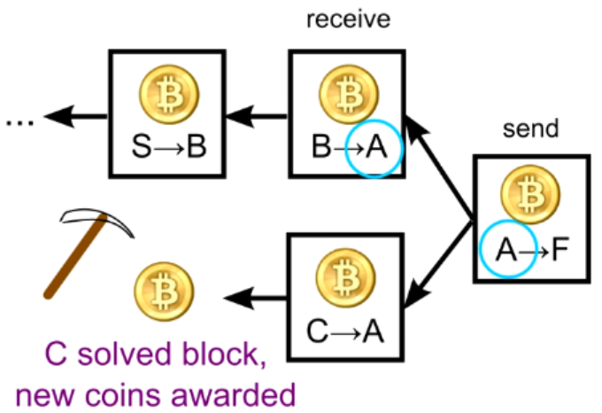
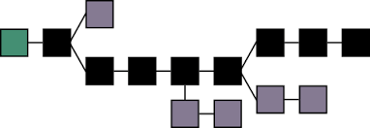
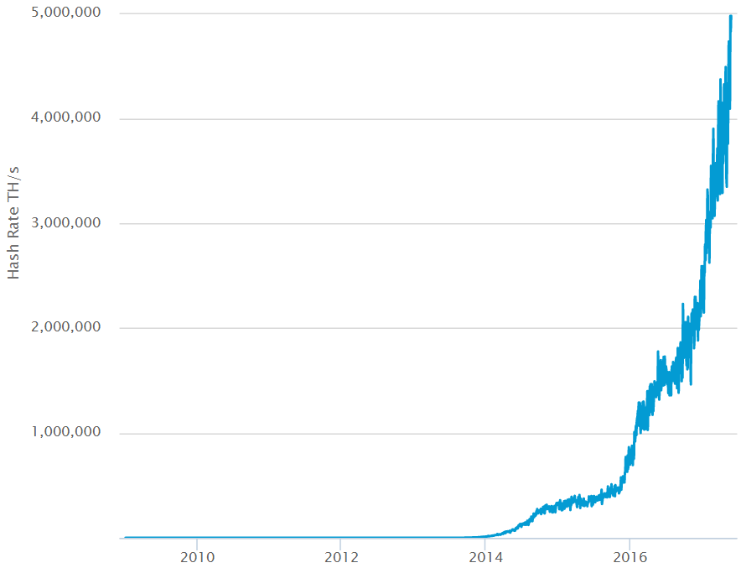
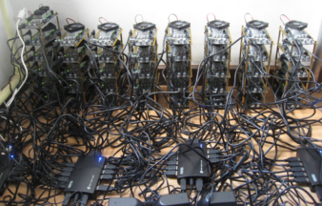
Mining
Real purpose:
Verify transactions
Safeguard the block chain
Mining:
Every 4 years, cut in half, every 10 minutes
all 21 million in 2140
Current 16.3 million
Smallest: 1/100,000,000 BitCoin = 1 Satoshi
Future: transactions
How 10 minutes:
Adjust difficulty every 2016 blocks, (around 2 weeks)
Links

Slide 24
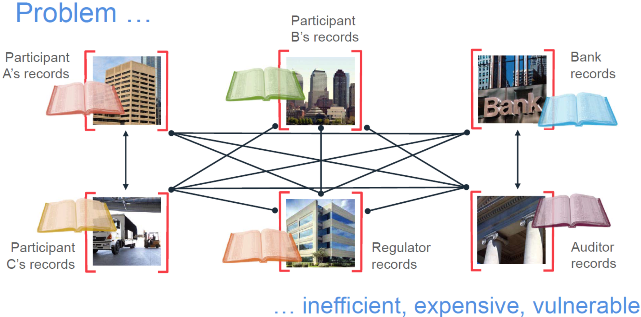
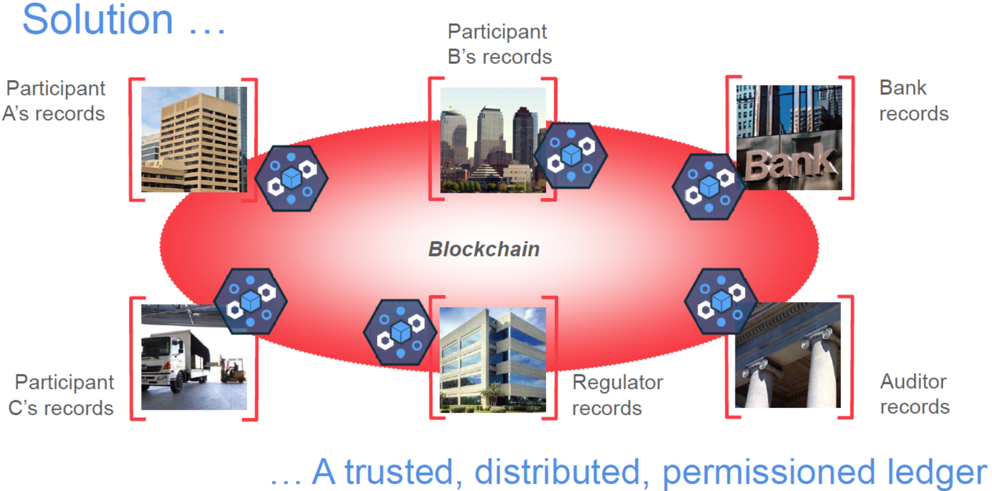
Chain Applications
Permanent and transparent records of transactions
Distributed, encrypted, trusted ledgers
Secure, indelible, consensus based, auditable
Permissioned or permissionless, replicated
Potential of eliminating intermediaries

Slide 25
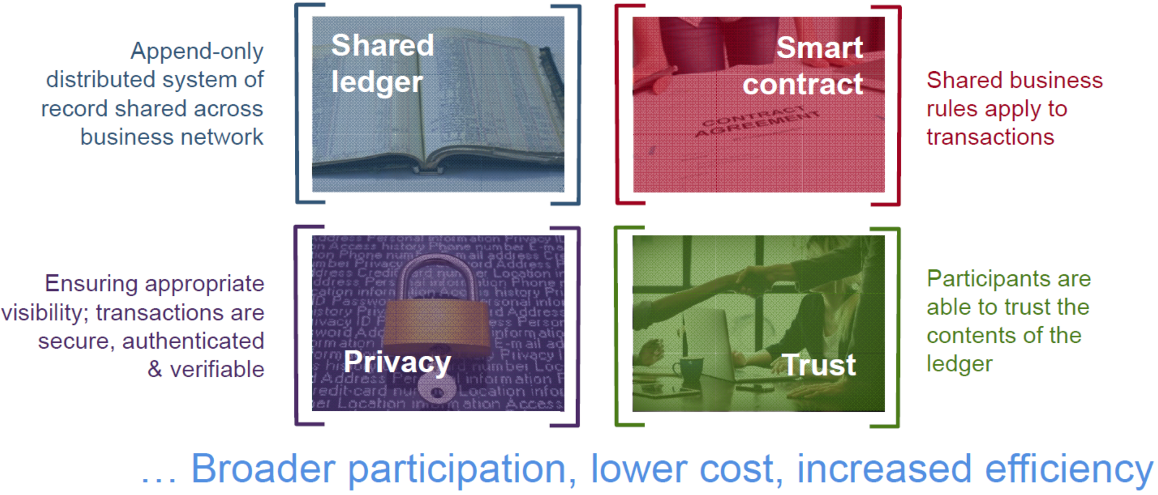
Blockchain for business

Slide 26
Shared ledger & Smart Contract
Shared ledger
Shared between participants
Participants have own copy through replication
Permissioned, so participants see only appropriate transactions
THE shared system of record
Records all transactions across business network
Smart Contract
Verifiable, signed
Encoded in programming language
Example:
Defines contractual conditions under which corporate Bond transfer occurs
Business rules implied by the contract … embedded in the Blockchain and executed with the transaction

Slide 27
Privacy & Trust
Privacy
Participants need:
Appropriate confidentiality between subsets of participants
Identity not linked to a transaction
Transactions need to be authenticated
Cryptography central to these processes
The ledger is shared, but participants require privacy
Trust
Participants endorse transactions
Business network decides who will endorse transactions
Endorsed transactions are added to the ledger with appropriate confidentiality
Assets have a verifiable audit trail
Transactions cannot be modified, inserted or deleted
The ledger is a trusted source of information

Slide 28
Specific Applications
Smart Renting: air Bnb
Food safety: traceability
IBM Walmart, Tsinghua Univ.
Certification Transparent
Notarization: public trust
Uber-less transportation
验证学位信息
百度金融也发行了基于区块链技术支持的ABS（资产证券化）项目
在微信黄金红包中已开始应用区块链技术进行数字资产的并行记账
Public blockchain
Private Blockchain
42 Banks alliance: R3CEV
Alliance blockchain
Notes:
Blockchain can transparently track the provenance of goods as they are passed from one organization to the next, building awareness and trust.
it supports an open source project called Hyperledger
One of the biggest philosophical o
obstacles is trust: Companies must get comfortable with the idea that their supply chain data won’t "live" in a central location.
终于把区块链的技术与应用讲清楚了: http://www.sohu.com/a/115881554_481636

Slide 29
Summery
Benefits
Government can’t print money or manipulate currency
Anonymity
Lower global transaction costs
Challenges
Difficult to exchange
Used for illegal activity (Government can’t track
Mining, or solving blocks use large amount of energy
Mathematically protected digital currency
Maintained by a network of peers
Digital Signature:
Safeguard money
Transaction chains
Store history of ownership
Block Chain
Hold transaction order

Slide 30
Q & A

Slide 31
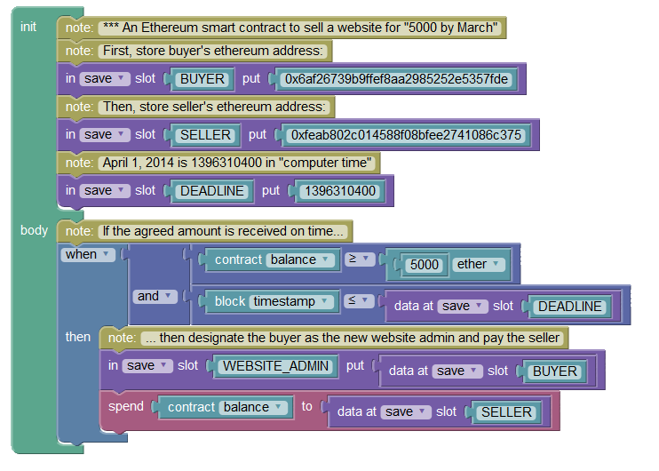
Ethereum

Slide 32
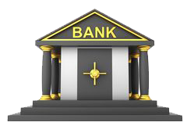
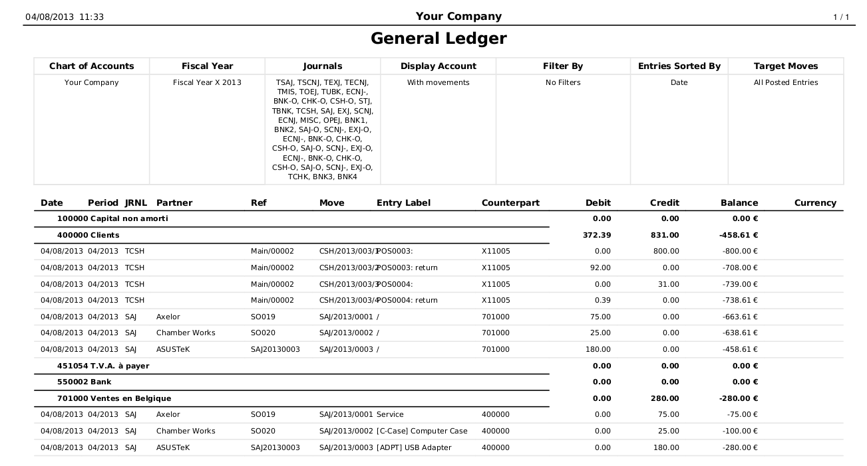


Slide 34
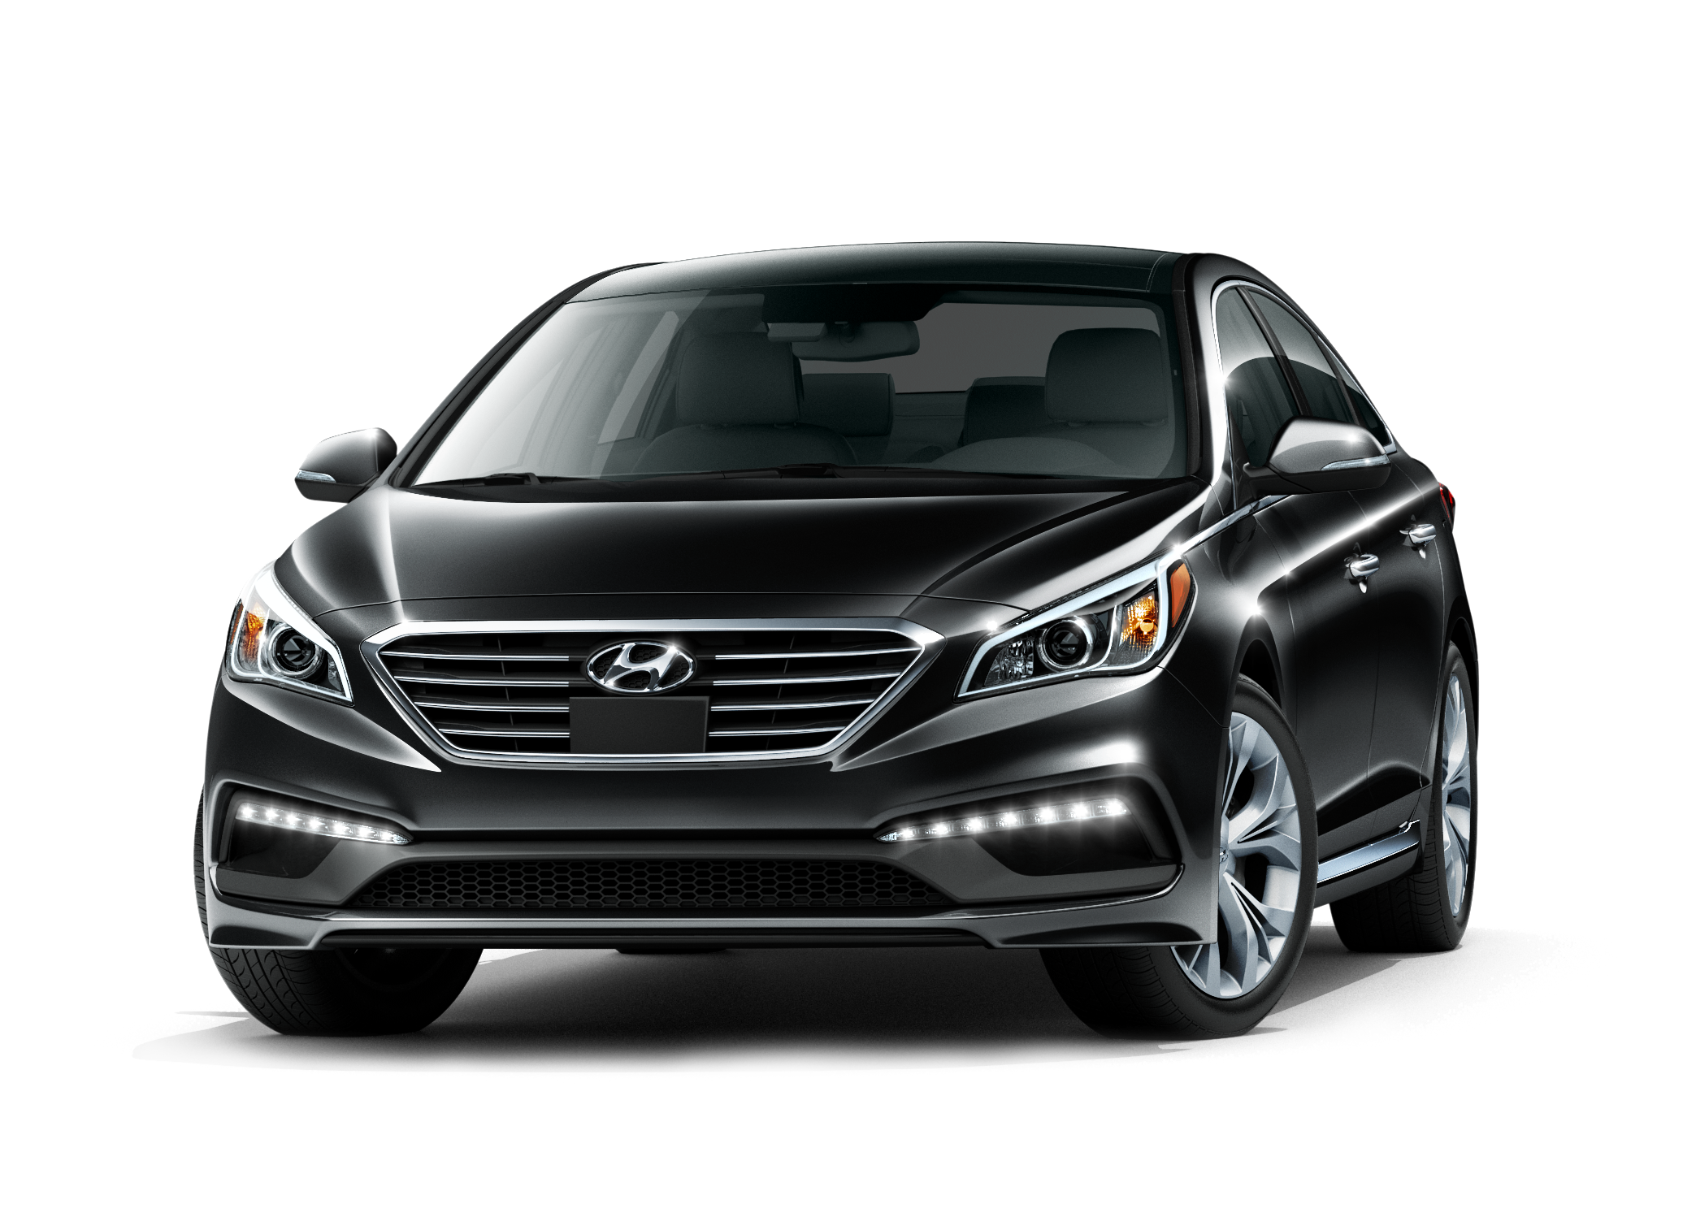
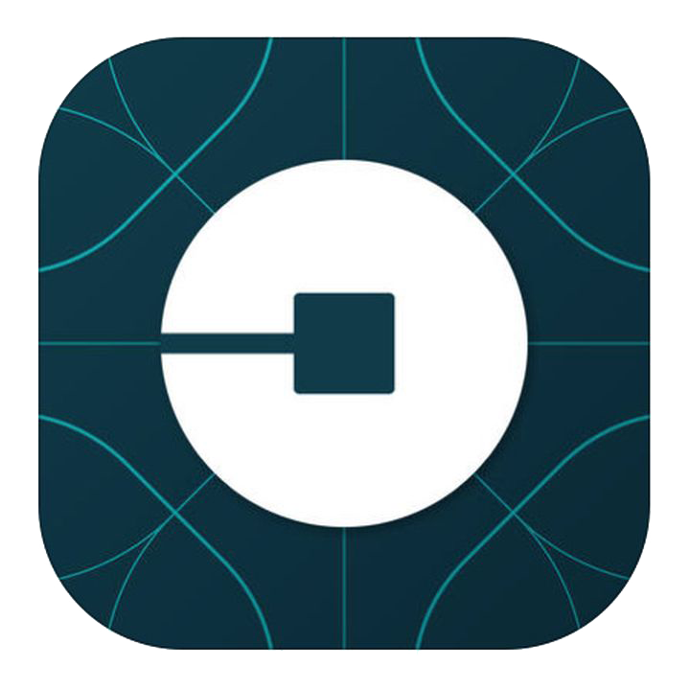


Slide 36
Cryptographic Basic – Large Numbers
Find a particular 256 bit (32 byte) number
Enumerate all numbers (finite) @ 1 billion/sec (1GHz)
2³⁰ | billion = giga 10^9 1,073,741,824 | 1 sec
2⁴⁰ | trillion = tera 10^12 1,099,511,627,776 | 18 mins
2⁵⁰ | 1,125,899,906,842,620 | 13 days
2⁶⁰ | 1,152,921,504,606,850,000 | 36 years
2⁹⁰ | 1*10^27 | 39 billion years
2¹²⁸ | 3*10^38 | 10 million-trillion years
2²⁵⁶ | 1*10^77 | 3*10^60 years
Total Number of Atoms on Earth: 2^160

Slide 37
Cryptographic Basics - Hash
Nonce: A large (>128 bit) random number. No two nonces are equal
Cryptographic Hash
Not two inputs produce the same output hash!
If you know the input, you can easily compute the hash
You cannot find ANY input that produces a particular hash
Hash Function
Input Data Bits, large number
256
bit hash

Slide 38
Cryptographic Basics - Asymmetric encryption
Public Key Encryption
Lock sensitive msg with public key, unlock with private key
Digital Signatures
3rd party verify (via public key) that send by owner (private key)
Public key (k1)
Input (plaintext)
Encrypt
Output (ciphertext)
Encrypt
Plaintext (same as input)
Private key (k2)
Encrypt hash with private key
Hash of input
Input Document

Slide 39
Reference documents
How do bitcoin transactions work
The Challenges of Block Chain Indexing
Blockchain platform evolution
IOTA: A Cryptoplatform for Securing Transactions on the IoT
Why IBM sees blockchain as a breakthrough for traceability

